Slide 1
To create your own AMI from an EBS backed EC2 instance's (root volume)
After launching EBS backed EC2 Instance update the root volume as required (software, patches, apps..etc)
(IIS install in windows server)
Stop the instance to ensure data consistency and integrity then create the AMI
AWS registers the created AMIs automatically

Slide 2
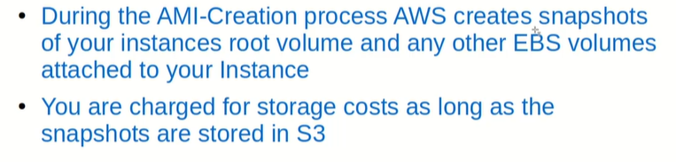

Slide 3
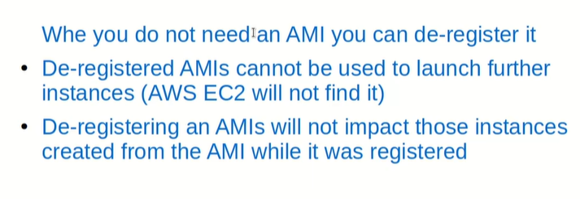

Slide 4
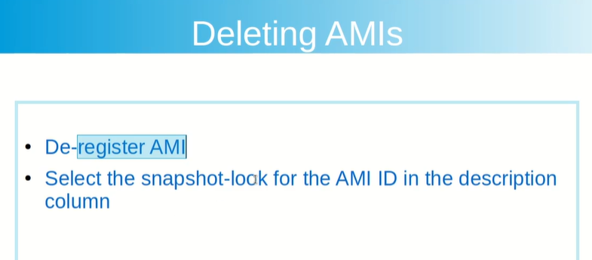

Slide 5
Elastic Load Balancing

Slide 6
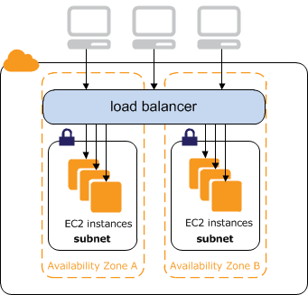
Elastic Load Balancing

Slide 7
Elastic Load Balaning
An Internet facing load balancer has a publicly resolvable DNS name
Domain like reuters.com is resolved to
-ELB DNS name
-Instead of EC2 IP address

Slide 8
Elastic Load Balaning
Registered EC2 instances are those that are defined under the Target Group
The Target Group also monitors the health of its registered instances
Traget Group ensures that it routes traffic only to Healthy instances

Slide 9
Elastic Load Balaning
Deleting the ELB does not affect or delete the EC2 instances registered with it
Before you delete the ELB, it is recomended that you point the Route53 (or DNS server) to somewhere else other than ELB

